Slide 1
Java Flow Control
Lecture 3

Slide 2
outline
If-else in Java
Switch-Case in Java
Java For loop
Java While loop
do-while loop in Java
Java Continue statement
Java Break statement

Slide 3
If-else in Java
if statement
nested if statement
if-else statement
if-else-if statement
//Syntax for nested if
if(condition_1) { Statement1(s); if(condition_2){ Statement2(s);
}
}
//Syntax for if
if(condition){
Statement(s);
}

Slide 4
//Example if statement
public class IfStatementExample {
public static void main(String args[]){
int num=70;
if( num < 100 ){
System.out.println("number is less than 100");
}
}
}

Slide 5
public class IfElseIfExample {
public static void main(String args[]){
int num=1234;
if(num <100 && num>=1) {
System.out.println("Its a two digit number");
}
else if(num <1000 && num>=100){
System.out.println("Its a three digit number");
}
else if(num <10000 && num>=1000) {
System.out.println("Its a four digit number");
}
else if(num <100000 && num>=10000) {
System.out.println("Its a five digit number");
}
else {
System.out.println("number is not between 1 & 99999");
}
}
}

Slide 6
Homework
Q: write two java programs to find the largest among three numbers.
Using if-else..if
Using nested If
Q: Write a java program compare two user input numbers (using if else if )
Q: Good Morning, Good Afternoon, Good Evening ….

Slide 7
Switch Case statement in Java
Switch case statement is used when we have number of options (or choices) and we may need to perform a different task for each choice.
Syntax:
switch(variable or an integer expression) {
case constant :
// code block
break;
case constant :
// code block
break;
default:
// code block
}

Slide 8
Break statement in switch case
Break statement is optional in Switch Case but you always need to use it!
Reference Example…
The default keyword specifies some code to run if there is no case match:

Slide 9
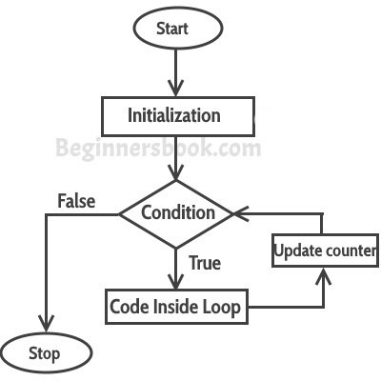
For loop in Java
Syntax:
for(initialization; condition ; increment/decrement) {
statement(s);
}

Slide 10
For loop in Java
Initialization:
  In the initialization part, variables like loop counter (you will generally see i and j in loops, these are the loop counters) are initialized.
  This is an optional part of the loop as the variables can be initialized before the loop.
  This executes only once when the loop starts.
Condition:
  This is one of the important part of the loop.
  This condition determines till when the loop should keep repeating.
  The loop keeps repeating until the condition becomes false.
Increment/Decrement:
  In this part of the loop declaration, you can specify the increment or decrement of loop counter.
  This is to modify the loop counter value so that at one point condition becomes false and the loop ends.
Statement:
  The statements inside the loop body keeps executing for each iteration of the loop until the loop stops.

Slide 11
Java Nested for loop
Infinite for loop
HW Q:
Find the Factorial Using For Loop
Write program to print fibonacci series using for loop

Slide 12
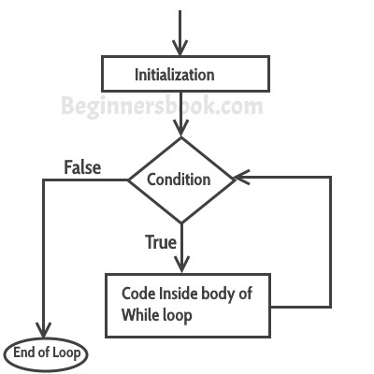
While loop in Java
Syntax:
while(condition) {
statement(s); //block of code
}

Slide 13
Infinite while loop
Reference Example

Slide 14
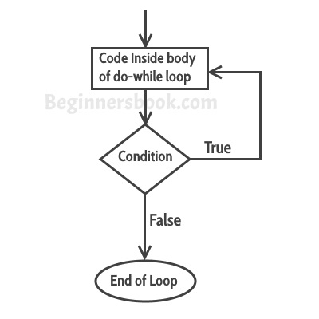
java Do/While Loop
Syntax:
do {
Statement(s);// code block to be executed
} while (condition);
Example:
int i = 0;
do {
System.out.println(i); i++;
} while (i < 5);

Slide 15
Continue Statement in Java
Continue statement is mostly used inside loops.
Whenever it is encountered inside a loop, control directly jumps to the beginning of the loop for next iteration, skipping the execution of statements inside loop’s body for the current iteration.
This is particularly useful when you want to continue the loop but do not want the rest of the statements(after continue statement) in loop body to execute for that particular iteration.

Slide 16
Break statement in Java
Use break statement to come out of the loop instantly.
Whenever a break statement is encountered inside a loop, the control directly comes out of loop and the loop gets terminated for rest of the iterations.
It is used along with if statement, whenever used inside loop so that the loop gets terminated for a particular condition.
The important point to note here is that when a break statement is used inside a nested loop, then only the inner loop gets terminated.
It is also used in switch case control. Generally all cases in switch case are followed by a break statement so that whenever the program control jumps to a case, it doesn’t execute subsequent cases (see the example below).

Slide 17
Java For-Each Loop
There is also a "for-each" loop, which is used exclusively to loop through elements in an array
Syntax:
for (type variableName : arrayName) {
// code block to be executed
}
Example:
String[] cars = {"Volvo", "BMW", "Ford", "Mazda"};
for (String i : cars) {
System.out.println(i);
}

